Slide 1
Test Driven Development (TDD)
An Introduction

Slide 2
What is TDD?
Test Driven Development (TDD) is a software development process where automated tests are written before the actual code implementation. The cycle of TDD typically involves writing a failing test, writing the code to pass the test, and then refactoring the code while ensuring that all tests still pass.

Slide 3
Benefits of TDD
1. Improved code quality
2. Faster development cycles
3. Reduced debugging time
4. Encourages modular and reusable code
5. Provides a safety net for refactoring

Slide 4
TDD Process
1. Write a failing test
2. Write the simplest code to pass the test
3. Refactor the code while ensuring tests still pass
4. Repeat the cycle for each new feature or requirement

Slide 5
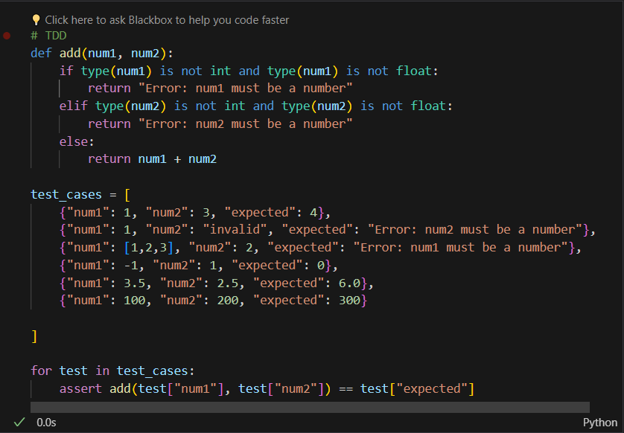
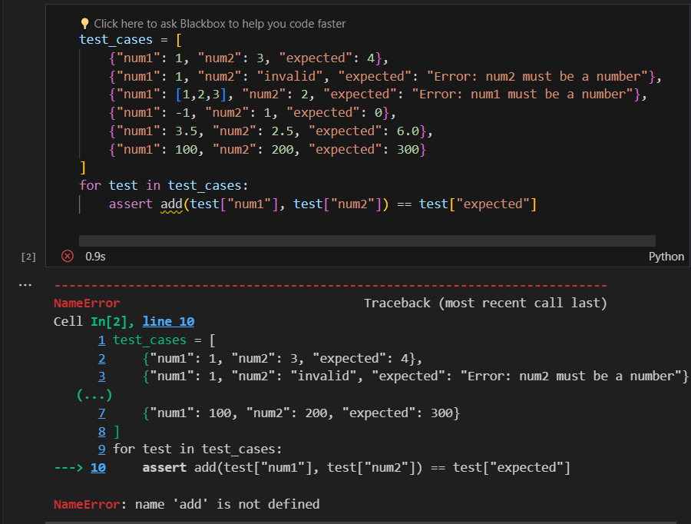

Slide 6
Conclusion
Test Driven Development is a powerful methodology that promotes code quality, agility, and confidence in software development. By following the TDD process, developers can create robust and maintainable codebases.

